Slide 1
Lead Score – Case Study
Submitted by:
Souvik haldar
Kaushtabh pasalkar
Greeshma eliyan

Slide 2
Problem statement
An X Education company needs help to select the most promising leads, i.e. the leads that are most likely to convert into paying customers. The company requires us to build a model wherein you need to assign a lead score to each of the leads such that the customers with higher lead score have a higher conversion chance and the customers with lower lead score have a lower conversion chance. The CEO, in particular, has given a ballpark of the target lead conversion rate to be around 80%.

Slide 3
Case study approach
Data Loading & Cleaning
Exploratory Data Analysis
Creating Dummy Variables
Train – Test Splitting of Data
Building a Logistic Regression Model
Evaluating the Model by different Measures and Metrices – Accuracy, Sensitivity, Specificity, Precision and Recall
Checking the Model Performance over Test Data by Confusion Metrix, Sensitivity, and Specificity

Slide 4
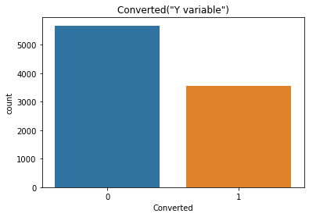
Exploratory Data Analysis
There is more than 35% Conversion rate in Total

Slide 5
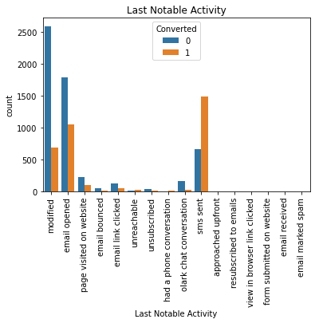
More users converted when the last notable activity was ‘sms sent’.

Slide 6
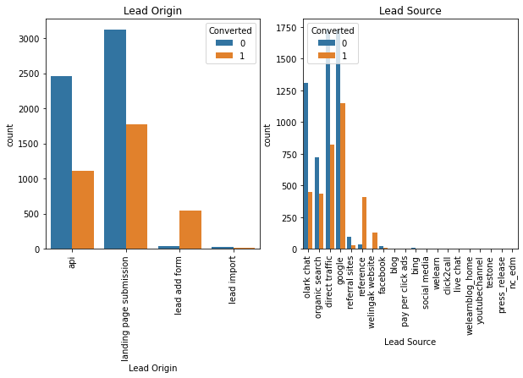
More conversion happened when Lead source was Google, Direct Traffic, Organic Search or Welingak website.
Also, conversion rate was high when the lead origin is ‘lead add format’.

Slide 7
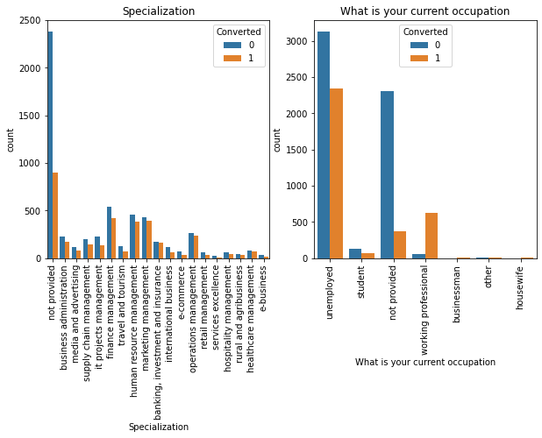
More potential users are working professional. They have more conversion rate.

Slide 8
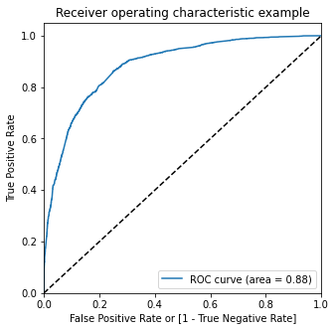
Model Evaluation – ROC Curve
The area under ROC curve is 0.87 which is a very good value

Slide 9
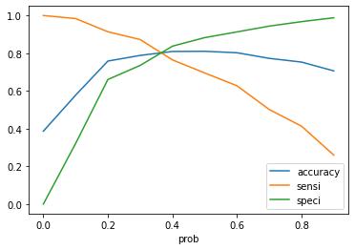
Model Evaluation on Train Data – Sensitivity and Specificity
Confusion Metrix
3438 | 457
748 | 1708
Accuracy - 81%
Sensitivity – 70%
Specificity – 88%

Slide 10
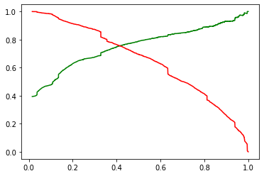
Model Evaluation on Train Data – Precision and Recall
Confusion Metrix
3289 | 606
593 | 1863
Precision – 75%
Recall – 76%

Slide 11
Model Evaluation on Test Data
Confusion Metrix
Confusion Metrix
1406 | 338
181 | 798
1472 | 272
232 | 747
Accuracy - 81%
Sensitivity – 82%
Specificity – 81%
Precision – 73%
Recall – 75%

Slide 12
Conclusion
It was found that the variables that mattered the most in the potential buyers are (In descending order) :
The total time spend on the Website.
Total number of visits.
When the lead source was: a. Google b. Direct traffic c. Organic search d. Welingak website
When the last activity was: a. SMS b. Olark chat conversation
When the lead origin is Lead add format.
When their current occupation is as a working professional.

